Slide 1
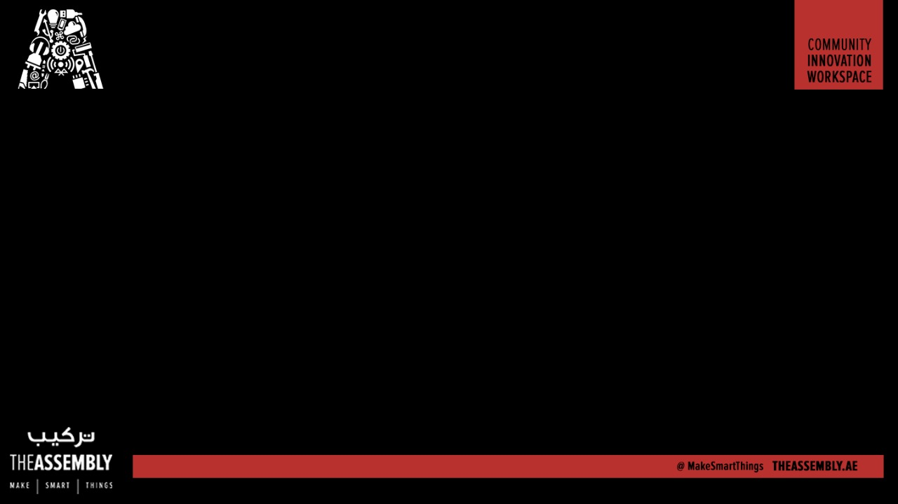
Make a Maze Learning MicroRobot
Presented By : The Assembly Team

Slide 2
Maze Solvers

Slide 3
What we are going to do

Slide 4
What else we could do
Notes:
*The HC-06 acts as a serial port through which you can send and receive data.
*So using a serial terminal or a Bluetooth customized application on your computer or phone, you can control and monitor your project.
*HC06 functions only as slave to a microcontroller

Slide 5
Break down of components

Slide 6
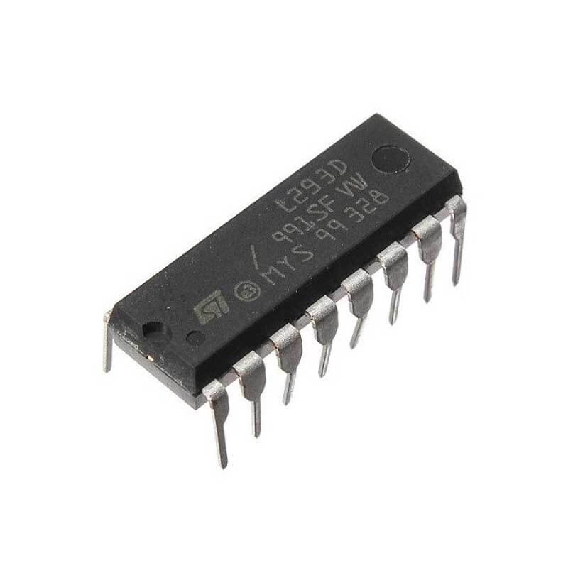
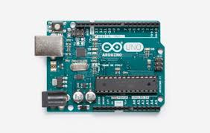
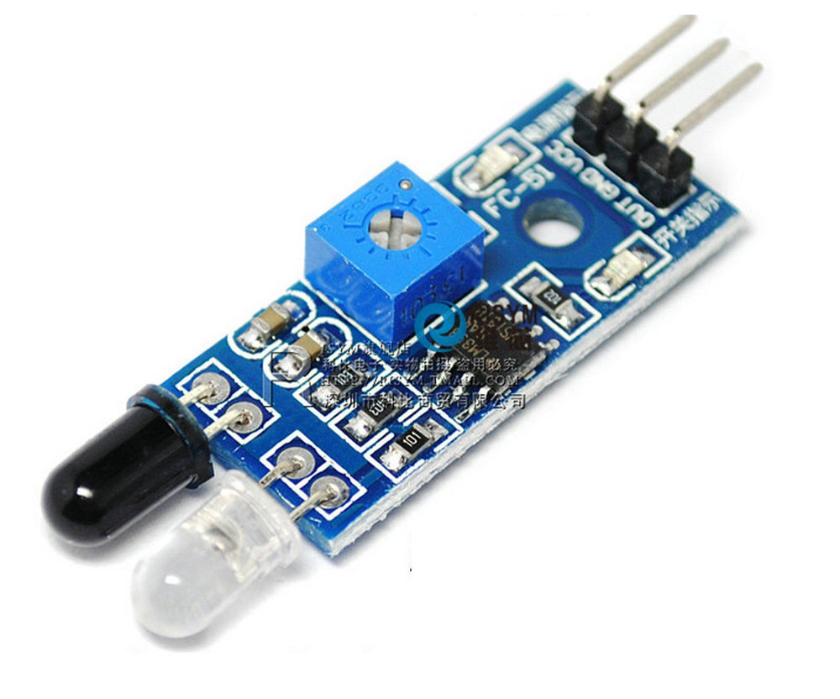
Infra Red Module
Arduino Uno
L293D Motor Driver

Slide 7
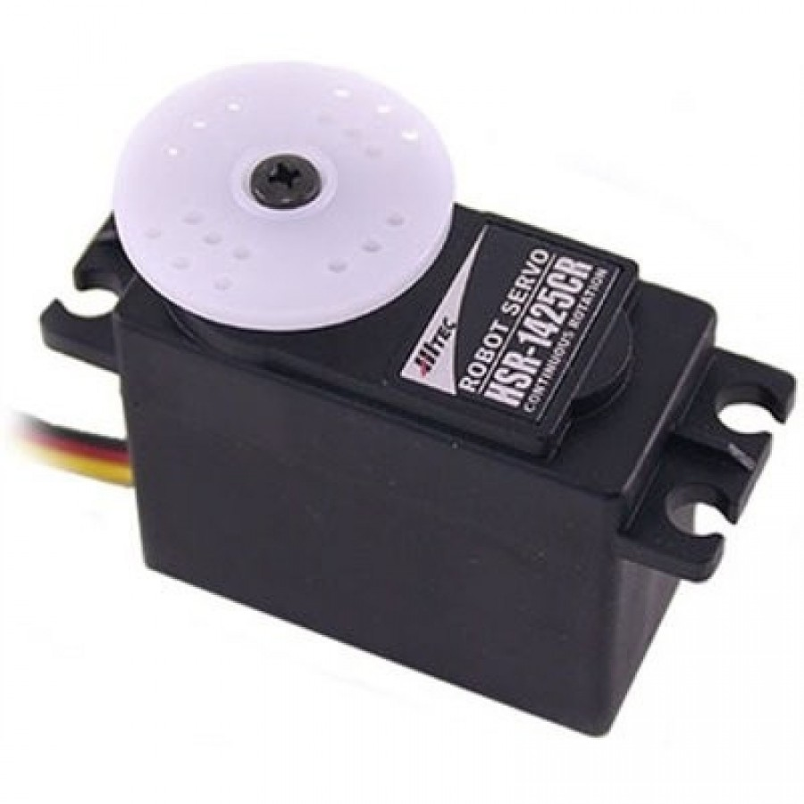
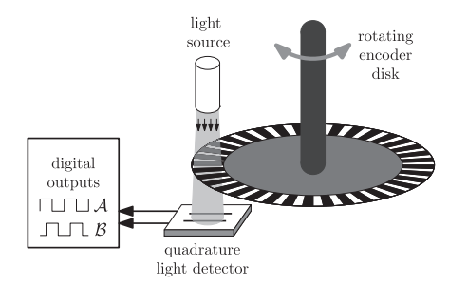
Missed Out Components
Continuous Servo Motor
Motor Encoders

Slide 8
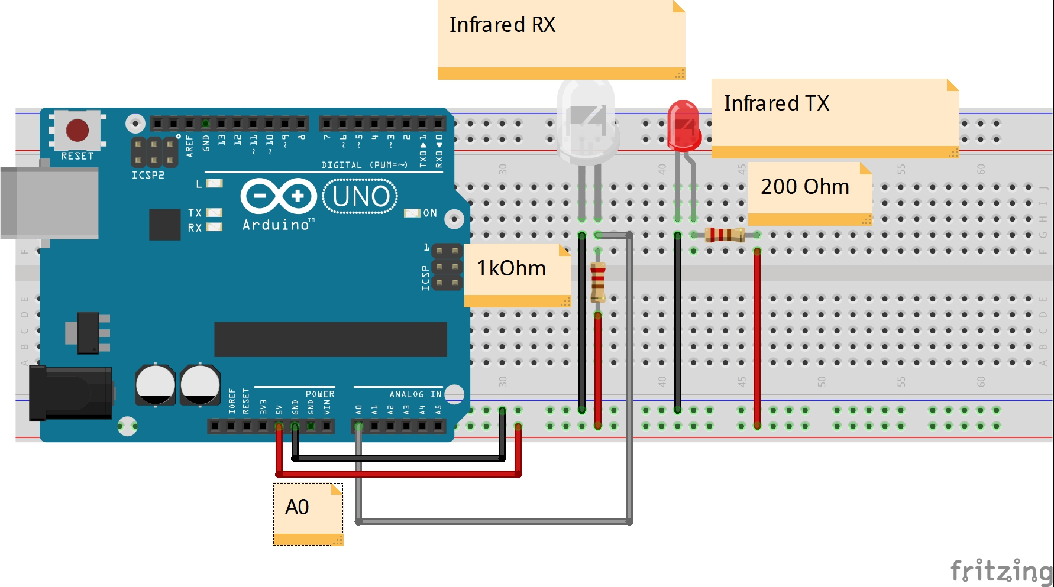
Infrared Modules

Slide 9
Motor Driver, Uno and Motors

Slide 10
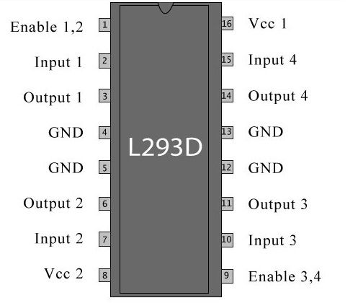
Motor Driver Pin out

Slide 11
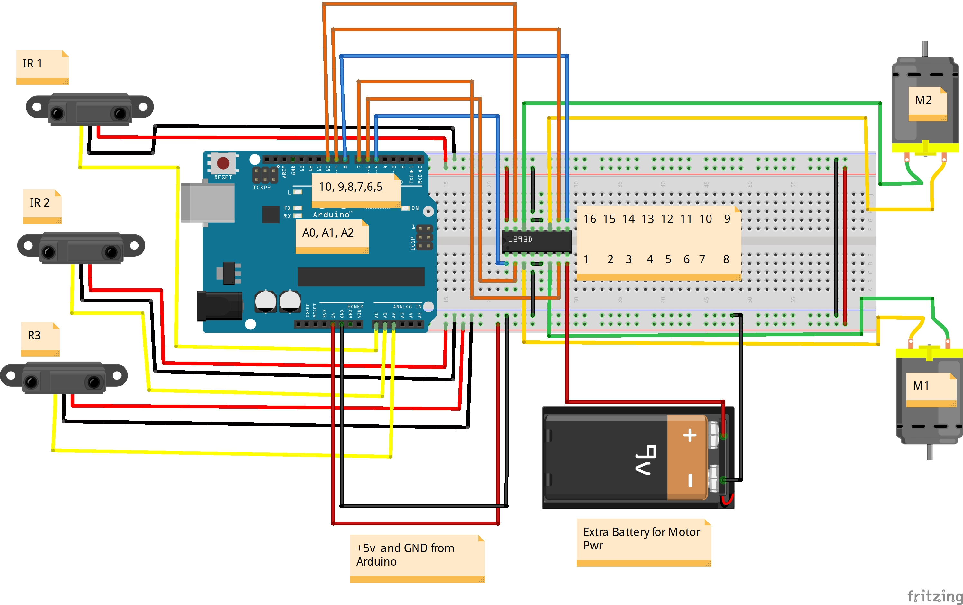
Notes:
Polylactic Acid (PLA)
Acrylonitrile butadiene styrene (ABS)

Slide 12
Connection
Arduino Pins | L293D Pins
Pin 5 | Pin 1
Pin 6 | Pin 2
Pin7 | Pin 7
Pin 8 | Pin 9
Pin 9 | Pin 10
Pin 10 | Pin 15
Arduino Pins | InfraRed Module Signal Pins
A0 | IR 1
A1 | IR 2
A3 | IR 3
L293D Pins | Motor Pins
Pin 3 | M1
Pin 6 | M1
Pin 11 | M2
Pin 14 | M2
Infra Red Modules Connection
Motor and IC Connection
Arduino and IC Connection

Slide 13
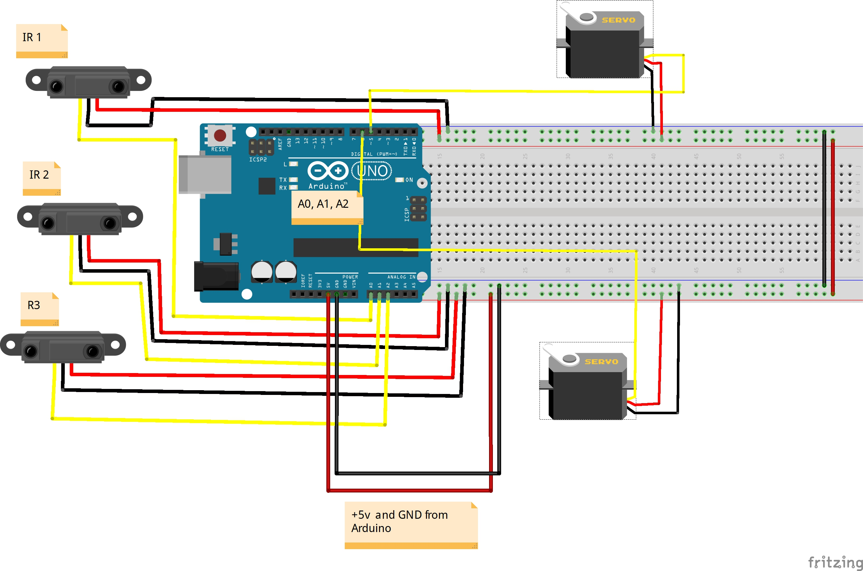

Slide 14
Types of Algorithm

Slide 15
Random Algorithm

Slide 16

Left/Right Algorithm

Slide 17
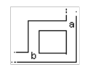
Branch and Return

Slide 18
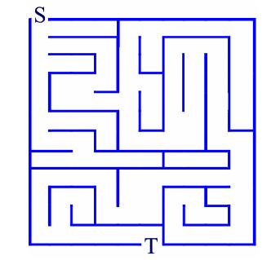
Paintbrush Algorithm

Slide 19
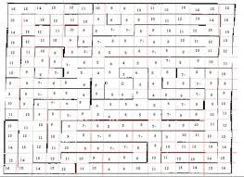
Flood Fill

Slide 20
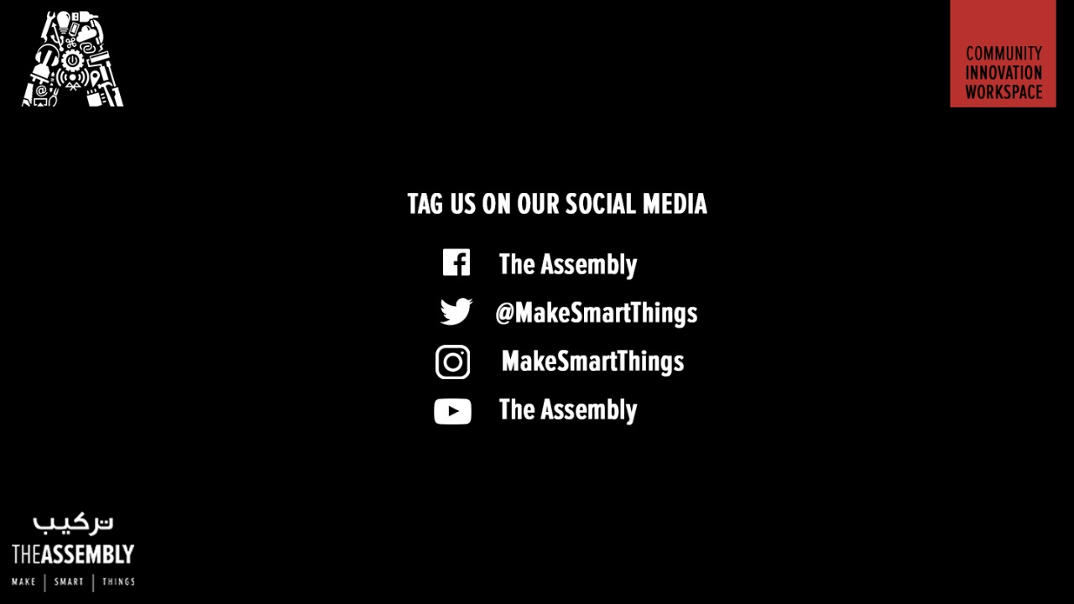
THANK YOU

